Slide 1


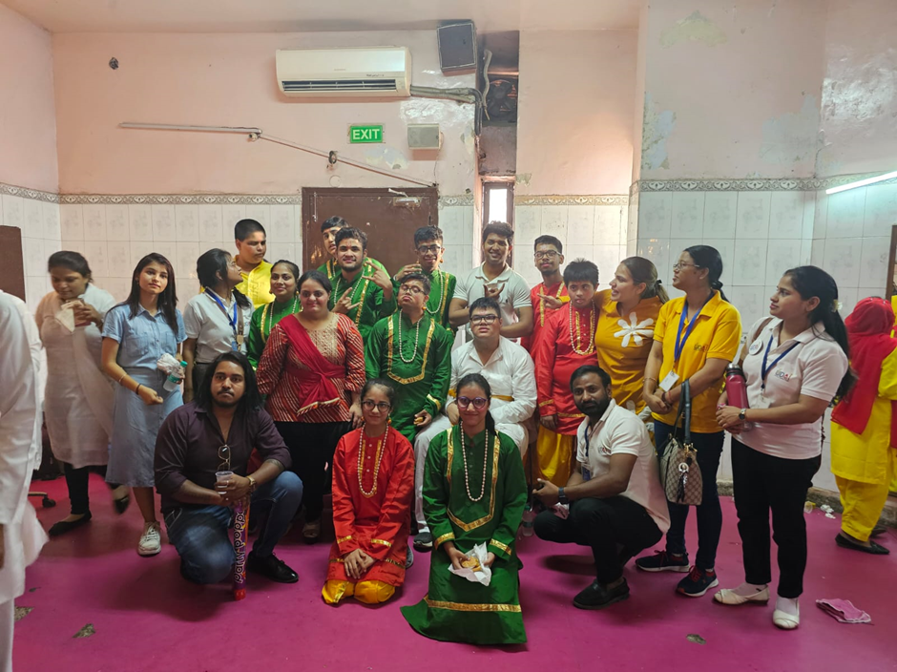
HOW CAN YOU HELP
UDAI WORKING TOGETHER WORKS
c

Slide 2
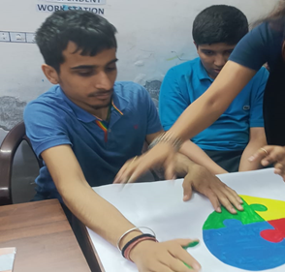
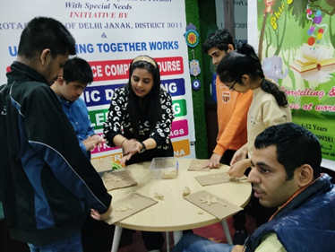
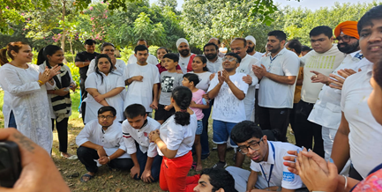
CONTACT
Sponsor Assistive Living Program
Vocational Unit
Project YOGYA
Project Harmony Café
Sponsor a Child
Wish List

Slide 3
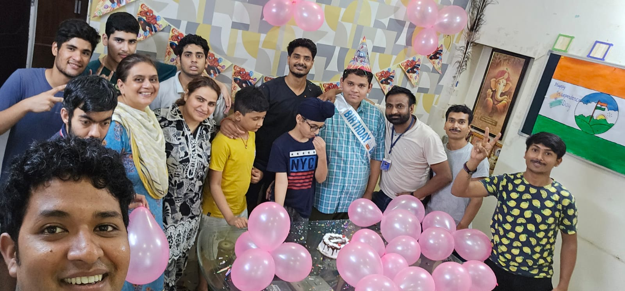
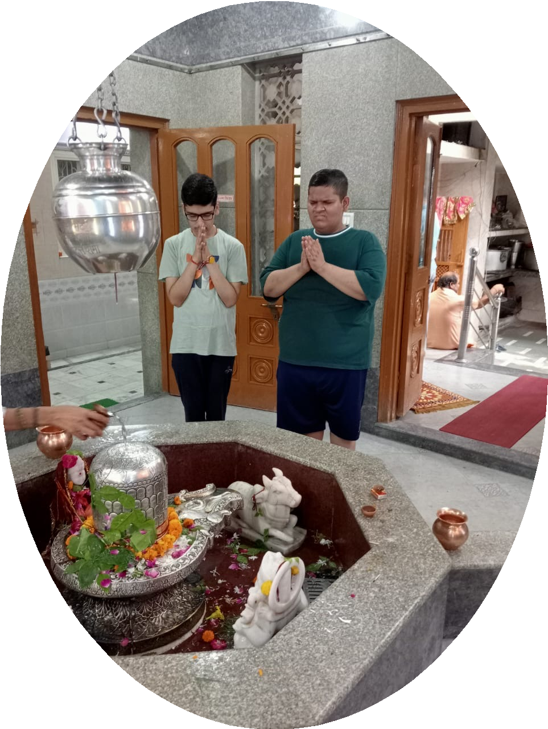
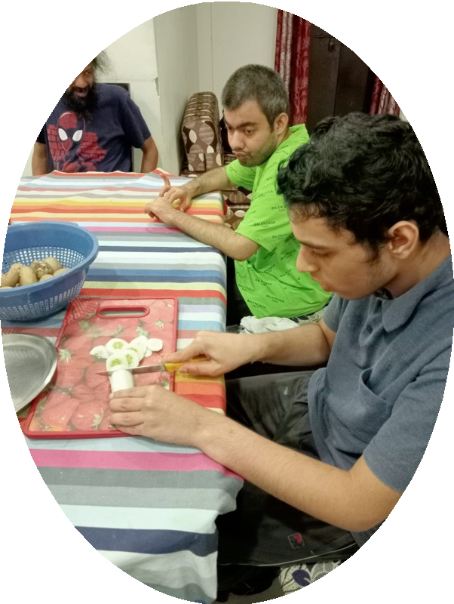
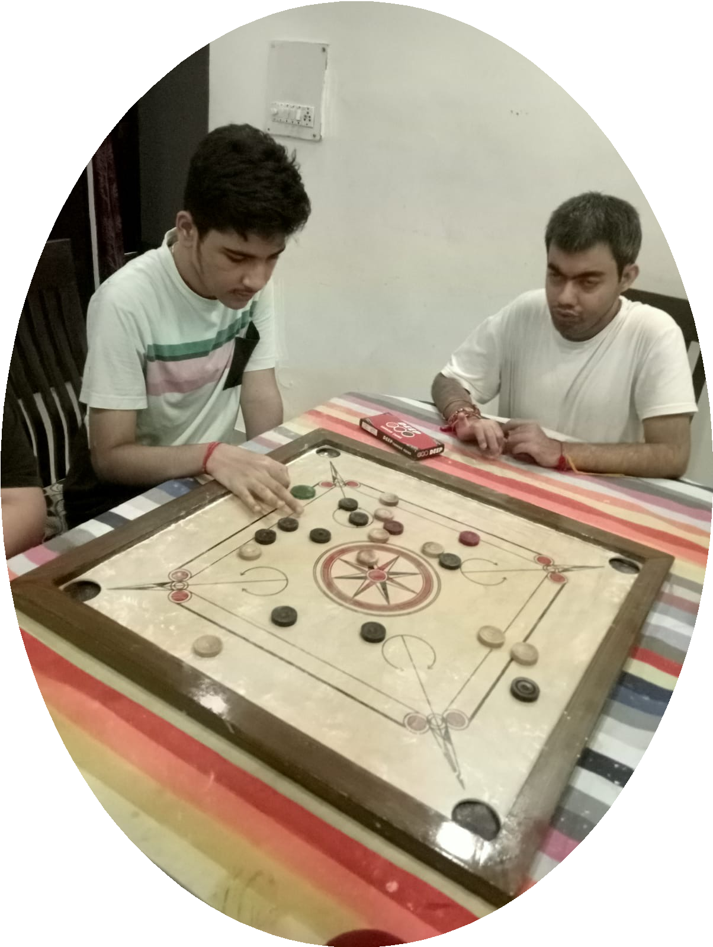
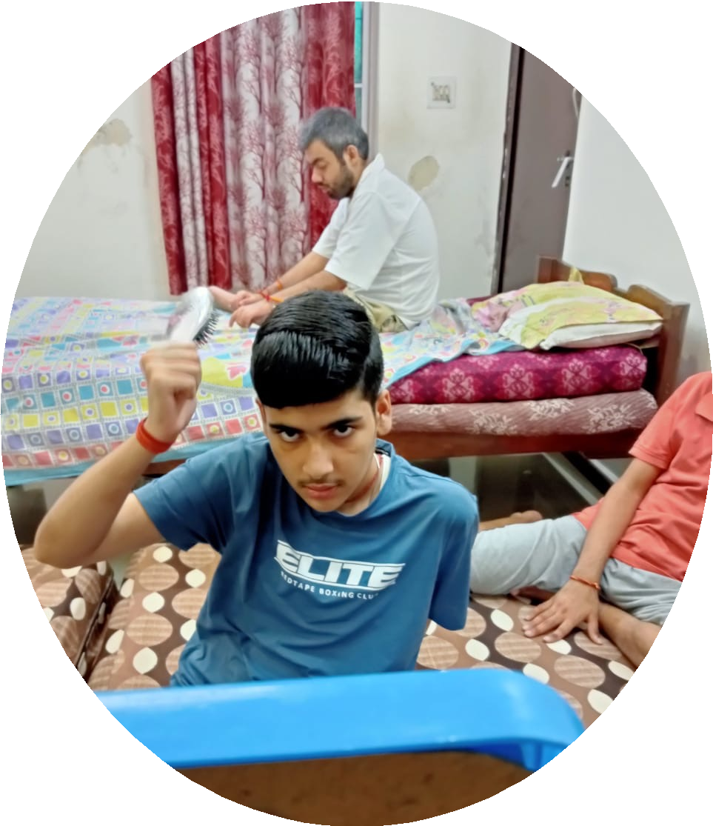
Sponsor our Assistive Living Program
Monthly Grocery of Rs. 50,000/-
Furniture: Sofa cum Bed and Chairs.
Appliances: AC, Microwave and Mixer.
Bills: Electricity, Gas and Rent
Child’s Medical Expenses

Slide 4
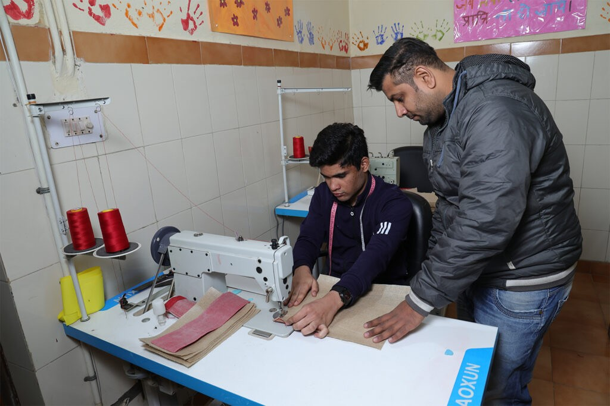
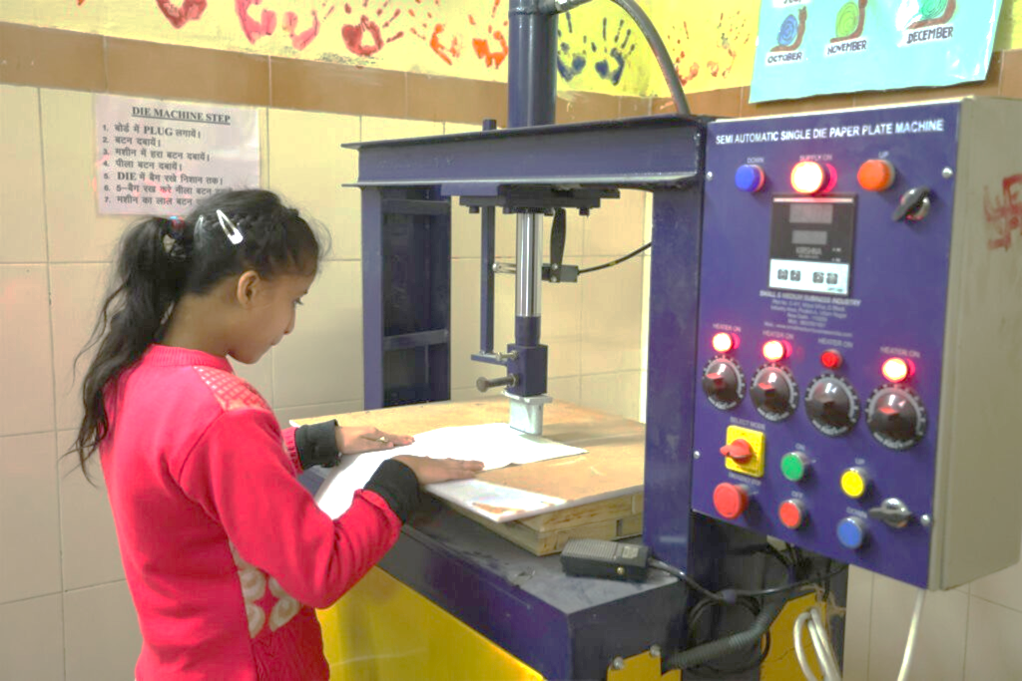
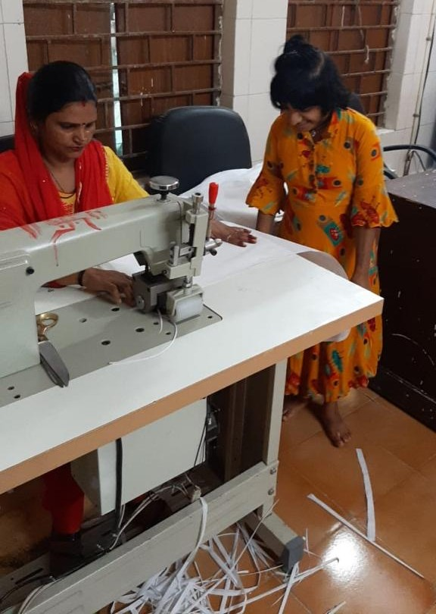

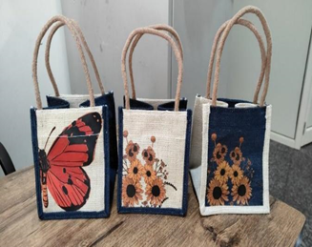
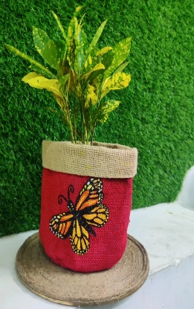
VOCATIONAL UNIT
Raw Material: Jute, Fabric, Canvas Rolls, MDF Board and Acrylic Board
DTF and Sublimation Printer sheets
Pinter Inks
Bills: Rent, Electricity
Stationary
For DTF and Sublimation printing: Plain T-shirts, Lowers, Short, Caps, Mugs, Coasters and Bottles
Home Décor: Calk Paint, Deco Stickers, Stencils and Marble powder

Slide 5




PROJECT YOGYA
Summary
Mobile Intervention Program to reach the unreached.
Community Based Rehabilitation Program.
Early Intervention.
Parents / Volunteer Training on TTT model
Execution
Staff will visit the selected areas by Bus
Visit the suburb twice a week.
Basic equipment's & docs will mobile intervention unit.
Identify schools /panchayat room in suburbs.
Expenditure
Capital Expenditure: Rs 10,00,000
Operational Expenditure: Rs 99,500/month
Support Required
Funds for operational expenses
A room in selected suburb
Permissions from local community
Existing Sponsors

Slide 6
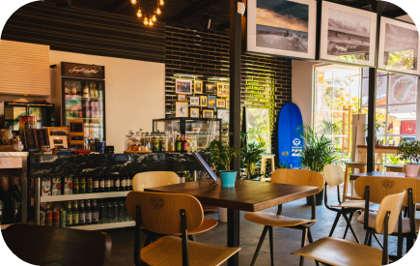
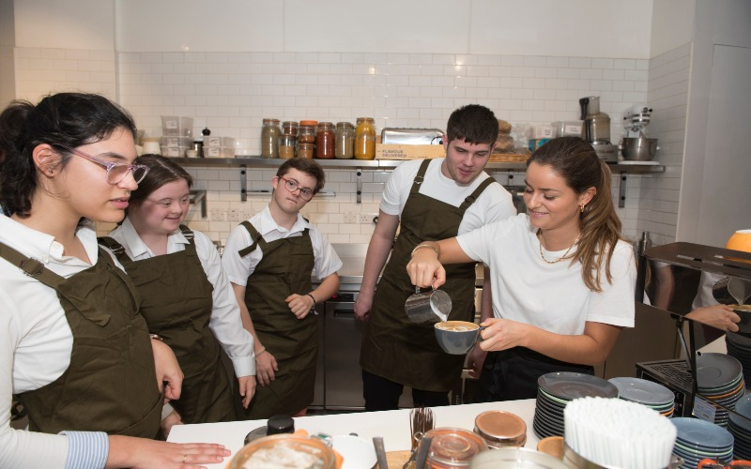
Project harmony café
Summary
Train Special Needs in culinary arts
Targeting adolescents and adults for vocational training and jobs.
Empowers individuals with skills and provides employment.
Establishes employment models, and hosts events and awareness campaigns.
Support Required
Financial Support
Community Support
Expert Collaboration
Awareness Campaigns
Execution
Design comprehensive training modules.
Create a structured employment model offering various roles.
Collaborate with vocational training experts
Continuous monitoring
Assess the social impact of the café on the community and participants
Expenditure
Capital Expenditure: Rs 15,00,000
Operational Expenditure: Rs 40,42,000/yearly

Slide 7
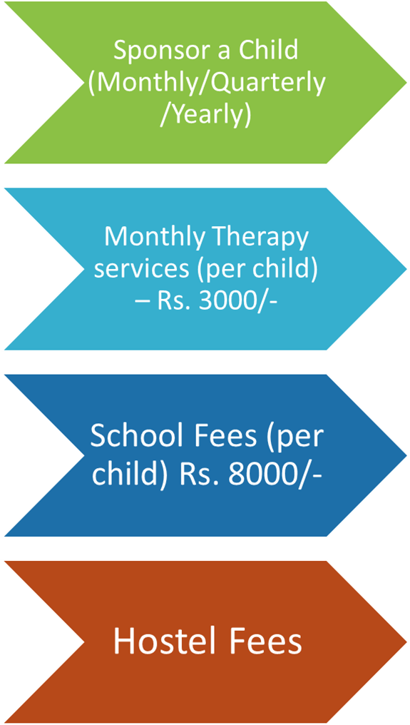
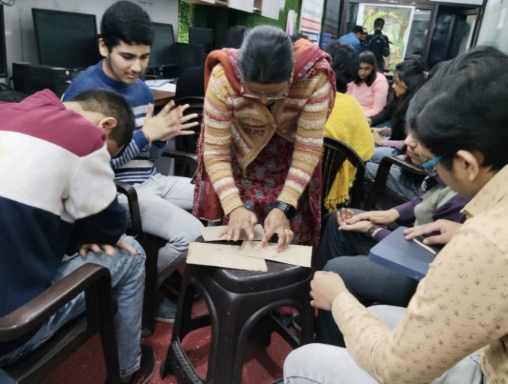
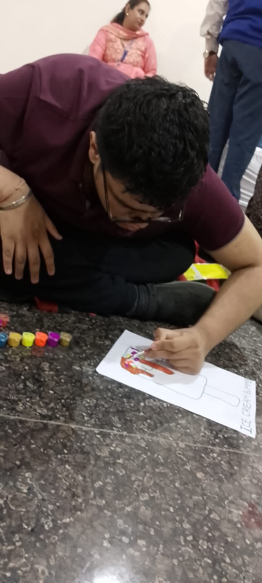
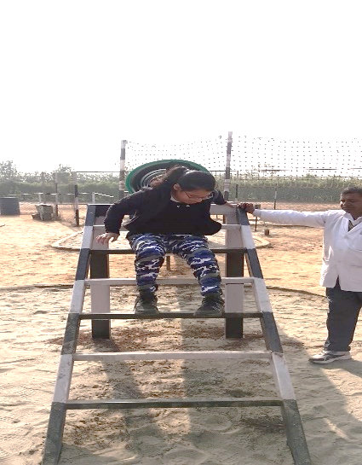
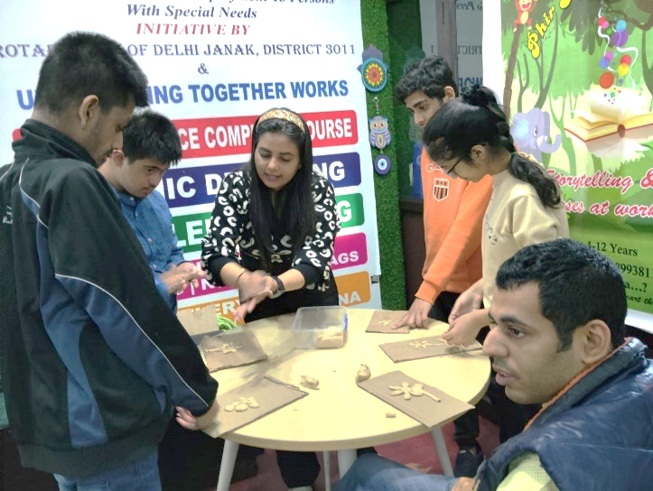
SPONSOR A CHILD

Slide 8
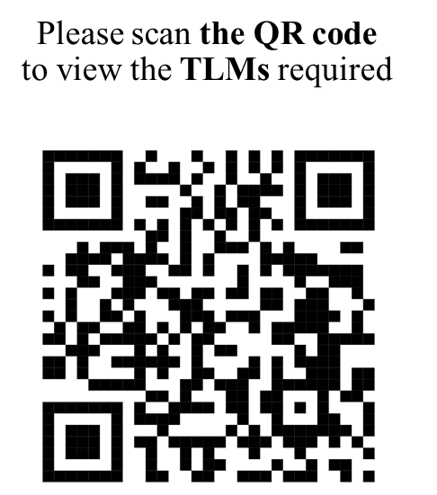


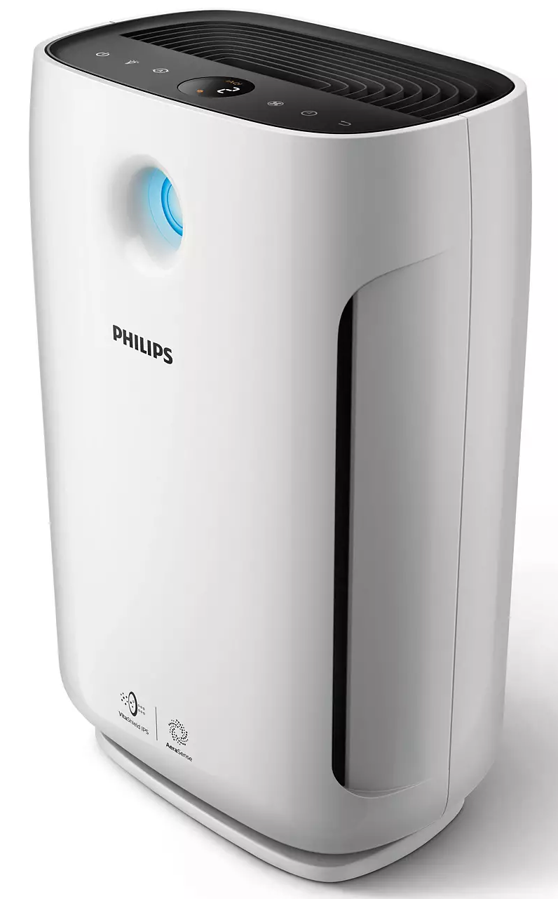
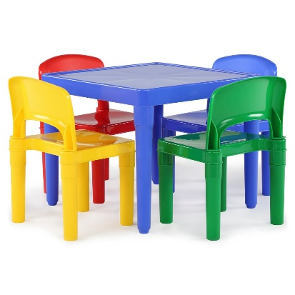
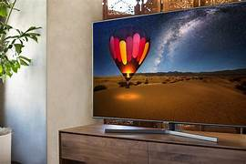
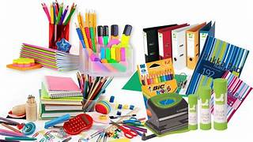

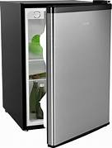
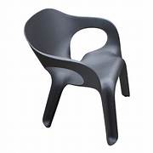
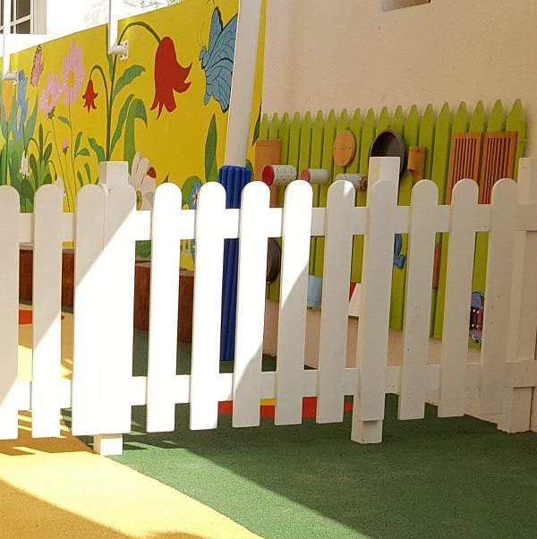
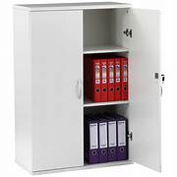
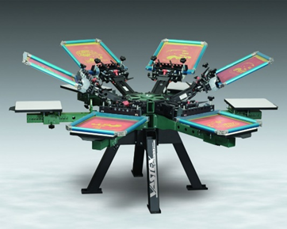
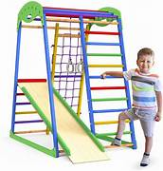
WISH LIST
AC
Computer
Air Purifier
Kids Chair and Table
Stationary
TV
Sensory Kit
Storage
Cupboards
Adult Chair
Screen Printing
Fridge
Guard Fence for Kids
Jungle Gym

Slide 9




THANK YOU
Let's all join together for a world that views disability not as a hindrance but as a unique attribute that can be seen as powerful asset, if given the right opportunities
Contact Us
UDAI Working Together Works
B3/39, Janakpuri, New Delhi
C-1 Chander Vihar, Sector 7, Dwarka
3559P, Sector 23,Gurgaon, Haryana
9899681972
www.udairehab.org
https://www.facebook.com/UdaiWorkingTogetherWorks/
https://www.instagram.com/udaispecialschool/

